Slide 1


Life of a BINFO student (LOBS)
Avdusinovic Sadin, Alex Bouchentouf, Simon Gourdon
BINFO (4th Semester)
2022/2023

Slide 2




Challenge:
Develop game / quiz / other tool to promote BINFO at the student fair and the OpenDay

Slide 3

Our promotion idea
Experience the 1st BINFO Semester

Slide 4



Game Idea 1 (University Walkthrough)
Start at the parking
Choose which building you want to visits
Need to solve some Math problems
Coding challenges
Win a trophy after a successful run
End in the LLC

Slide 5
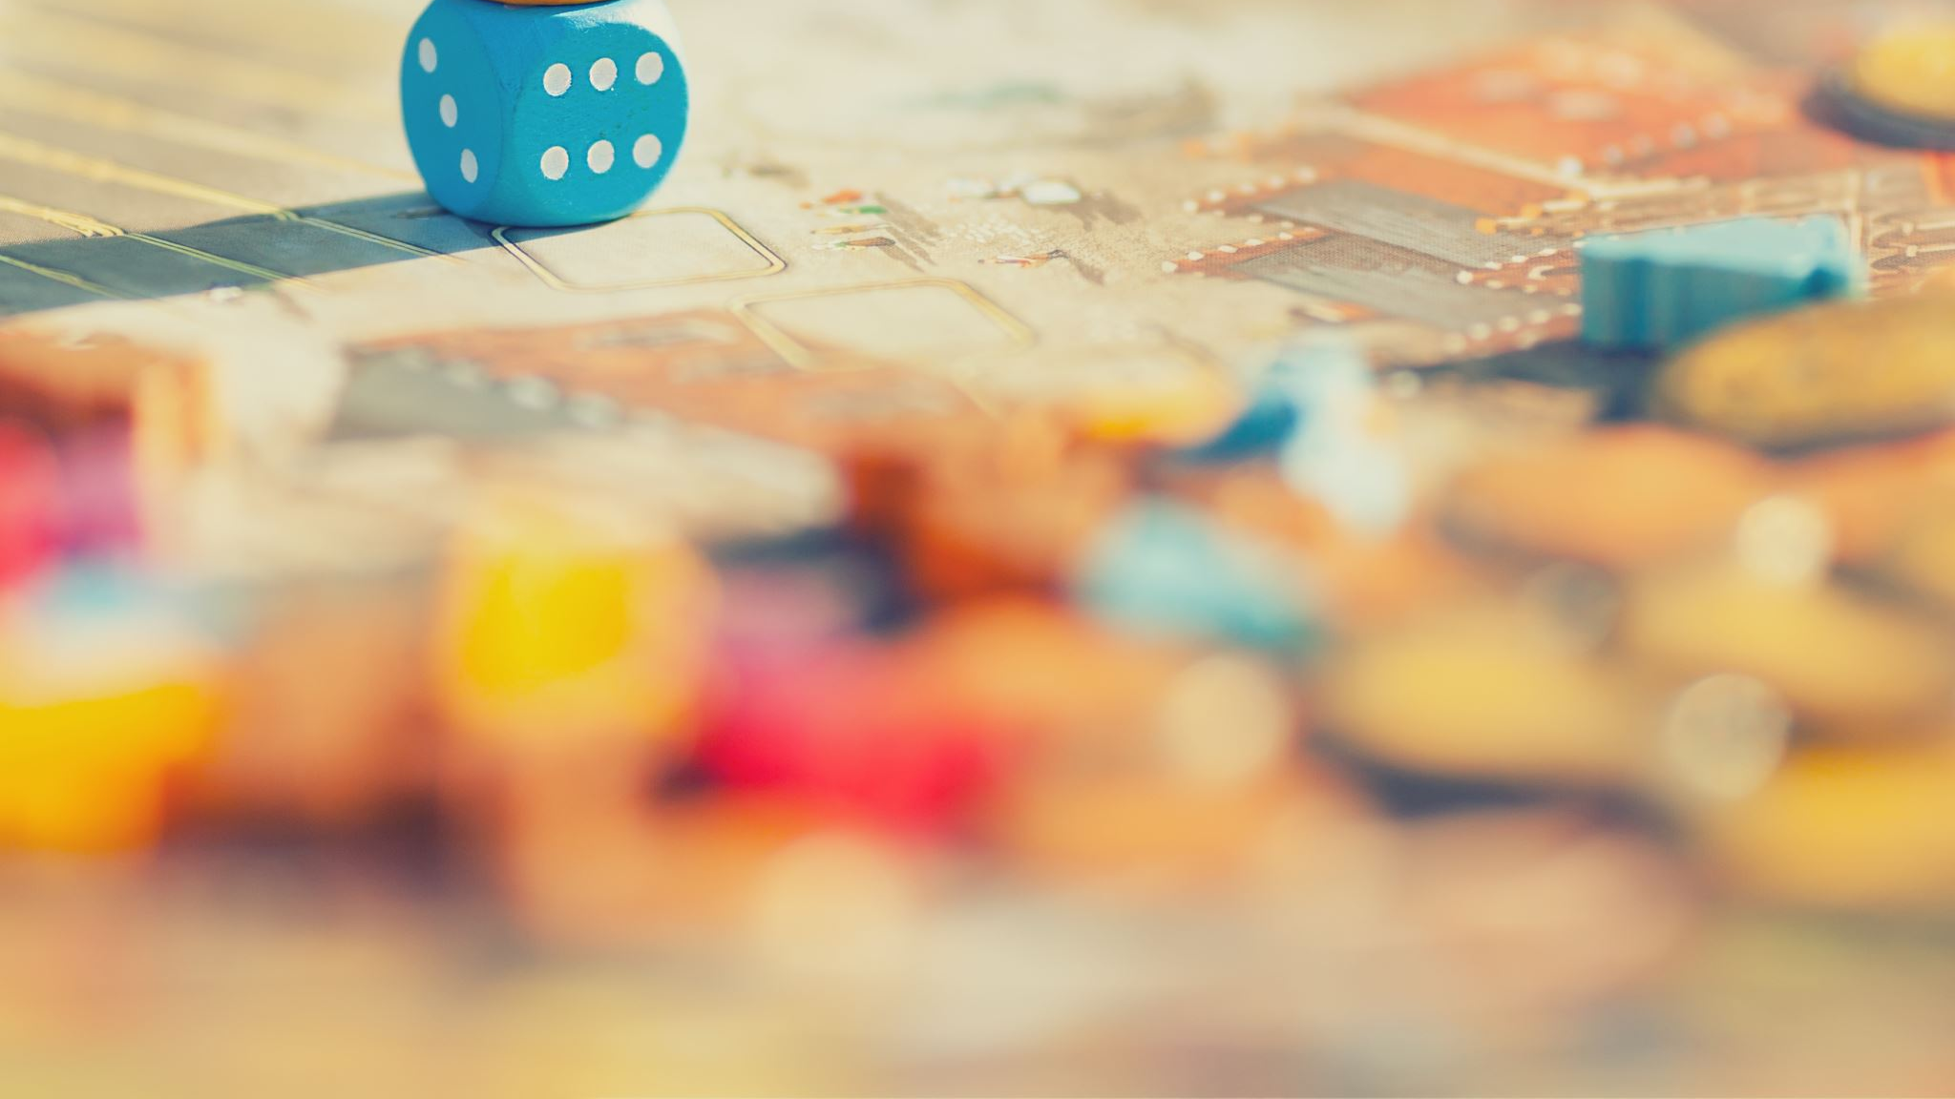
More details about the game

Slide 6
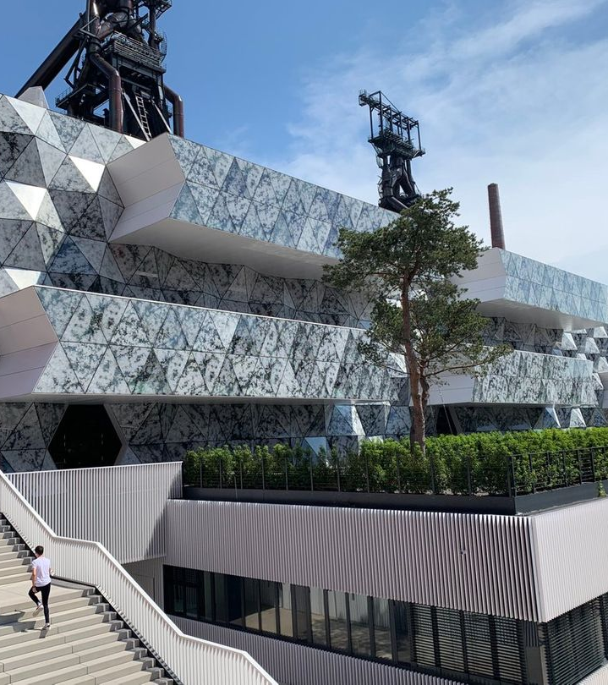
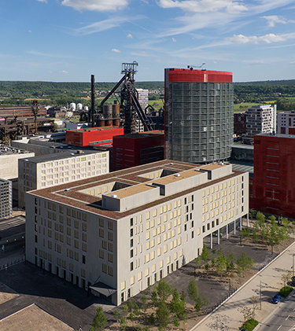
Location
Uni.lu campus
Parking
University
LLC

Slide 7
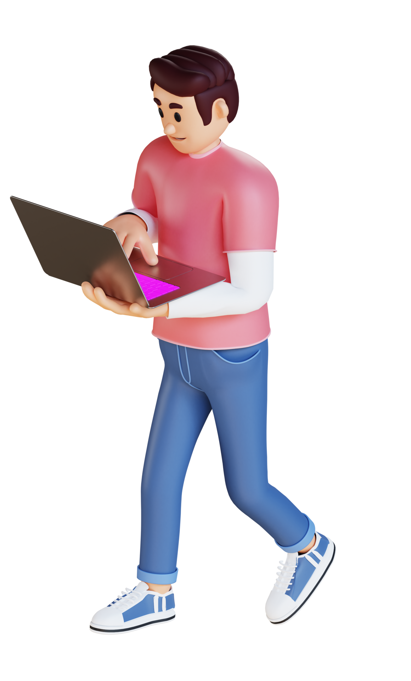

Main character
Currently there is just one character
Maybe we will add some characters later(for example: some professors)

Slide 8
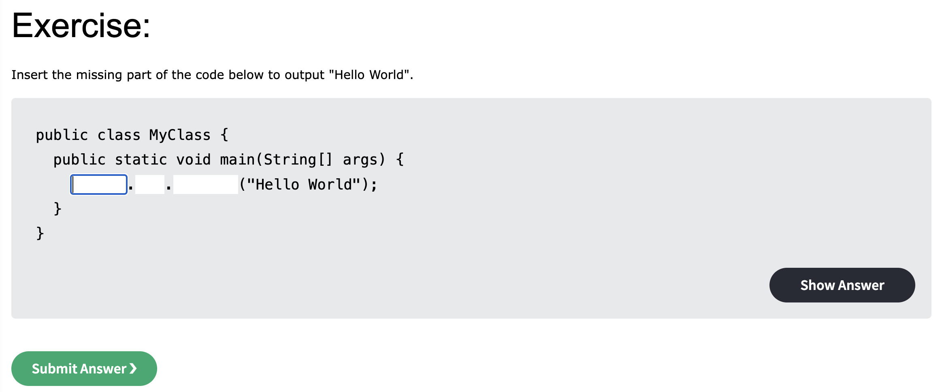
Coding challenges

Slide 9
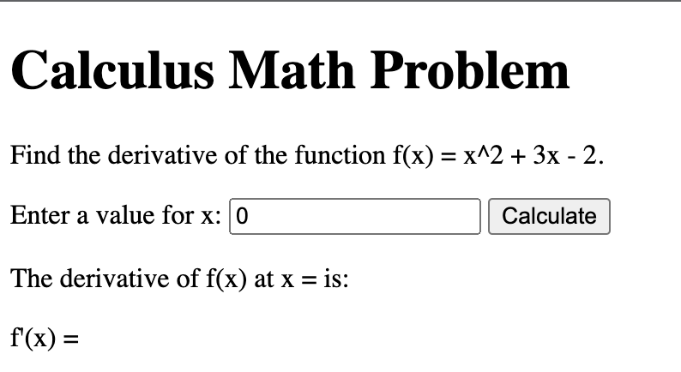
Solve math problems

Slide 10
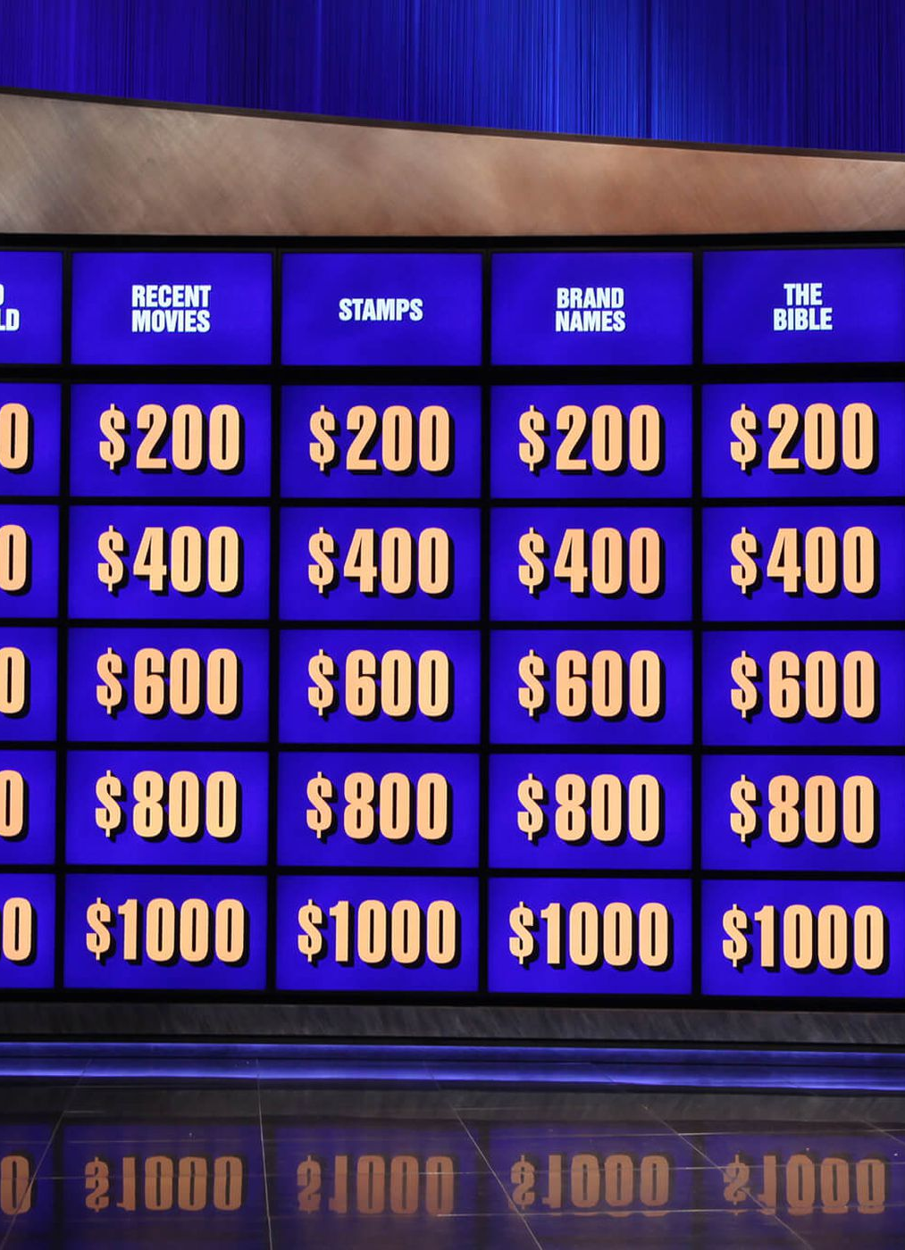
Game Idea 2 (Quiz /Jeopardy)
Different categories -> our courses
Aim->get certain points

Slide 11

Programming Language
Java
JavaScript (Web game)
Python
Unity (Gaming Engine)

Slide 12
Which software will we use from Software engineering?
Trello or Github ->Planning
Markdown ->Protocols
Web game -> Selenium(if it’s possible for the test cases)
SonarQube or SonarLint for the code

Slide 13
Sources:
https://cdn-icons-png.flaticon.com/512/6476/6476937.png
https://cdn-icons-png.flaticon.com/512/1839/1839113.png
https://cdn-icons-png.flaticon.com/512/419/419952.png
https://static.vecteezy.com/system/resources/previews/011/345/224/original/young-man-using-a-laptop-3d-character-illustration-png.png
https://static.vecteezy.com/system/resources/previews/011/343/643/original/young-man-in-hat-walking-with-laptop-3d-character-illustration-png.png
https://wwwen.uni.lu/var/storage/images/media/images/campus_belval_final_1/1014043-1-fre-FR/campus_belval_final_1.jpg
https://static.affluences.media/sites-pictures/sites/w7EHKWk54.jpeg

Slide 14

Thank you for your attention

